Slide 1
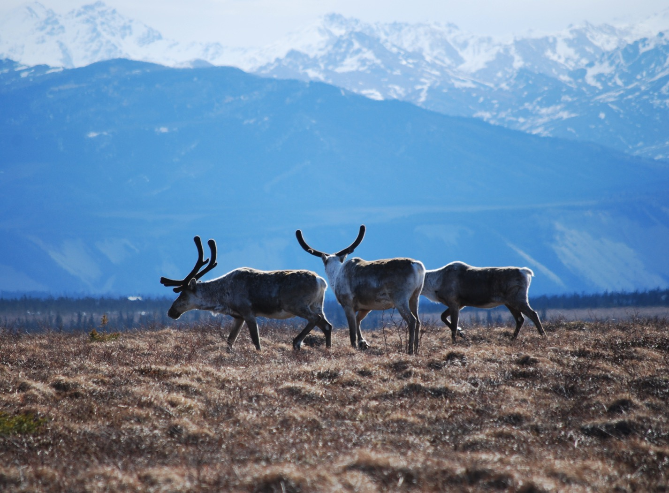
Arctic Boreal Vulnerability Experiment (ABoVE)
2017 ABoVE Airborne Campaign
25 May 2017 (DOY 145)
AirMOSS: Yellowknife – Fairbanks
Charles Miller, Deputy Science Lead
Jet Propulsion Laboratory, California Institute of Technology
and the ABoVE Science Team For Hank Margolis, Eric Kasichke, Bruce Tagg
NASA HQ
May 2017

Slide 2
25 May 2017/DOY 145 Yellowknife – Fairbanks
Assets Deployed:
Yellowknife (CFYZ) – AirMOSS (P-band SAR)/JSC G-III (N992NA)
Pilots: Tom “T-Rex” Ryan, Scott “Bonz” Reagan, Tom “Duster” Parent
Science Coordinator: N Pinto
Science Lead: M Moghaddam
Project Manager: Y Lou
Mechanics: Johnny Scott, Jim Fennel
Operators: Phil Vaughn, Dave Elliot, Rocky Smith, Roger Chao, Joanne Shimada
Daily Summary:
Science Flight
All sensors operating nominally

Slide 3
23 May 2017/DOY 143 72-Hour Look Ahead
All plans weather dependent
Friday 26 May 2017 (DOY 146):
Southwest Alaska
https://uavsar.jpl.nasa.gov/cgi-bin/report.pl?planID=PLAN_1121_v01#flightPlan
Saturday 27 May 2017 (DOY 147):
Yukon-Kuskokwim Delta
https://uavsar.jpl.nasa.gov/cgi-bin/report.pl?planID=PLAN_1114_v01#flightPlan
Sunday 28 May 2017 (DOY 148):
Down Day

Slide 4
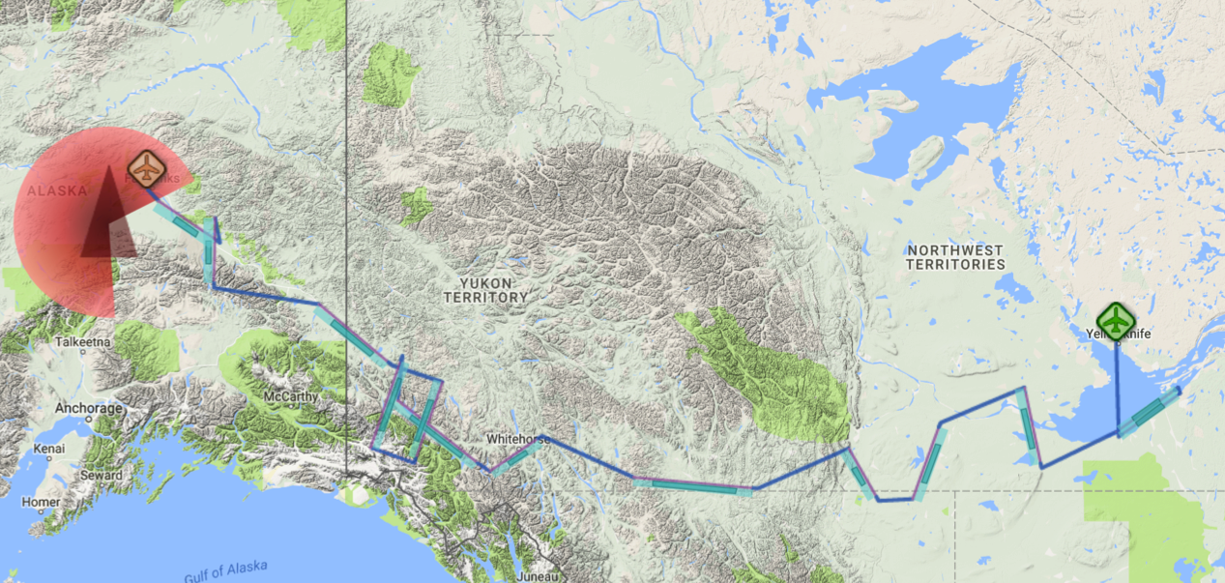
25 May 2017/DOY 145 Yellowknife – Fairbanks
Flight Plan 1119 v02: Yellowknife NT (CYZF) – Fairbanks AK (PAFA)
https://uavsar.jpl.nasa.gov/cgi-bin/report.pl?planID=PLAN_1119_v02#flightPlan
Data Acquisitions:
Line A ID 33409: Slave River
Line 1, ID 05528: Fort Resolution 1
Line 2, ID 23403: Fort Resolution 2
Line 3, ID 34808: Lake Kakisa
Line 4, ID 20025: Scotty Creek AOIs
Line 5, ID 33020: Ft Liard/CFS
Line 6, ID 27509: Watson
Line 7, ID 23601: Wolf Creek
DESCOPE Line 8, ID 30805: Kluane 1
DESCOPE Line 9, ID 19901: Kluane 2
Line 10, ID 01901: Kluane 3
Line 11, ID 31030: Tok, AK
Line 12, ID 00100: Delta Junc 1
Line 13, ID 30406: Delta Junc 2
00100
30406
01901
31030
34808
19901
30805
27509
05528
23403
33409
23601
20025
33020
5/23/17 flight plan & acquisition segments
Notes:
Notes: Pilots expect time/fuel pressure due to adding Line 5 from 5/23/17 plan (33409)
DECISION: Line 9 ID 19901 will not be collected
DECISION: Lines 12-13 will be acquired if time and fuel permit, but may be deferred to another flight day – not descoped

Slide 5
25 May 2017/DOY 145 Yellowknife – Fairbanks
A
B
C
D
E
AirMOSS Quick-look products
A. Line A ID 33409: Slave River
B. Line 1, ID 05528: Fort Resolution 1
C. Line 2, ID 23403: Fort Resolution 2
D. Line 3, ID 34808: Lake Kakisa
E. Line 4, ID 20025: Scotty Creek AOIs
Joanne Shimada, JPL
Notes:
Lines A-C collected to support AirSWOT study of Slave River watershed (A)/Slave Delta (B,C) for GNWT; B) ice on Great Slave Lake seen in left side of image near Fort Resolution

Slide 6
25 May 2017/DOY 145 Yellowknife – Fairbanks
A
B
C
D
AirMOSS Quick-look products
A. Line 5, ID 33020: Ft Liard/CFS
B. Line 6, ID 27509: Watson
C. Line 7, ID 23601: Wolf Creek
D. Line 10, ID 01901: Kluane 3
Joanne Shimada, JPL
Notes:
A) CFS studies in Fort Liard area indicate largest boreal forest productivity in NWT
B-C) These acquisitions support long-term measurements and Yukon Territory science

Slide 7
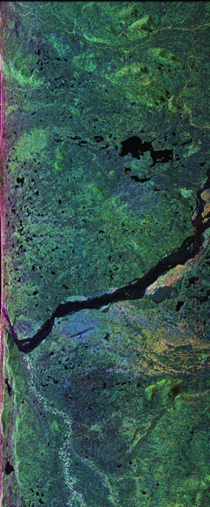
25 May 2017/DOY 145 Yellowknife – Fairbanks
A
B
C
AirMOSS Quick-look products
A. Line 11, ID 31030: Tok, AK
B. Line 12, ID 00100: Delta Jnc 1
C. Line 13, ID 30406: Delta Jnc 2
Joanne Shimada, JPL
Notes:
A-C) All overlap with extensive boreal forest RS acquisitions by G-LIHT
B-C) The Delta Junction transects sample one of the NEON intensive sampling areas

